Slide 1
Chapter 4:
Image enhancement in the frequency domain
Enhance : To make greater <as in value, desirability, or attractiveness>.
Frequency : The number of times that a periodic function repeats the same sequence of values during a unit variation of the independent variable
Webster’s New Collegiate Dictionary

Slide 2
Content
In this Chapter we will look at image enhancement in the frequency domain
  Jean Baptiste Joseph Fourier
  The Fourier series & the Fourier transform
  Image Processing in the frequency domain
    Image smoothing
    Image sharpening
  Fast Fourier Transform

Slide 3
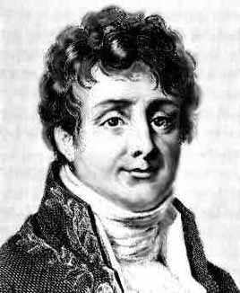
4.1 background
Jean Baptiste Joseph Fourier
Fourier was born in France in 1768
  Most famous for his work “La Théorie Analitique de la Chaleur” published in 1822
  Translated into English in 1878: “The Analytic Theory of Heat”
Nobody paid much attention to the first publication
One of the most important mathematical theories in modern engineering

Slide 4
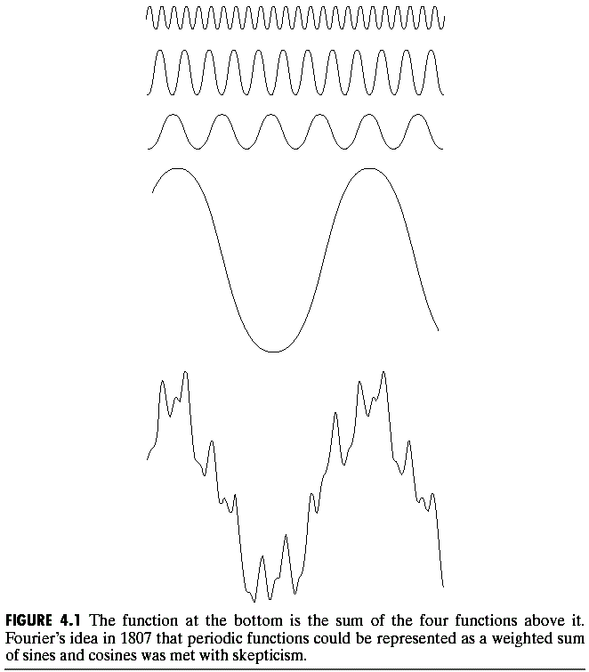
4.1 background
=
Any function that periodically repeats itself can be expressed as a sum of sines and cosines of different frequencies each multiplied by a different coefficient – a Fourier series

Slide 5
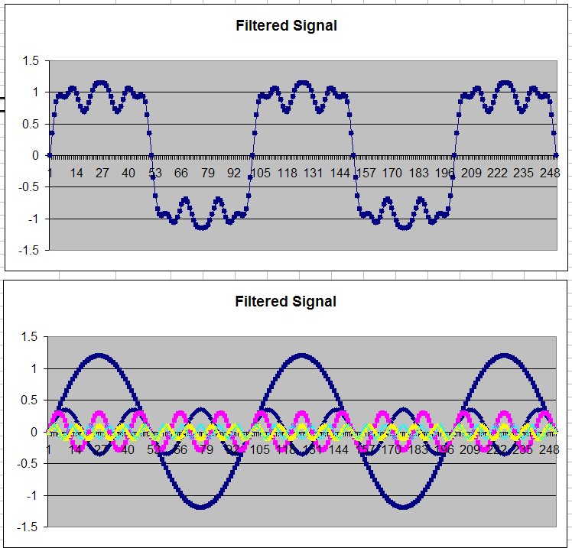
4.1 background
Frequency domain signal processing example in Excel

Slide 6
4.1 background
  Fourier transform:
  Even functions that are not periodic (but whose area under the curve is finite) can be expressed as the integral of sines and/or cosines multiplied by a weighing function. The formulation in this case is the Fourier transform
  The utility is even greater than the Fourier series
  In the past 50 years, entire industries and academic disciplines have flourished as a result of Fourier's ideas.
  Fast Fourier transform (FFT): revolutionized the field of signal processing.

Slide 7
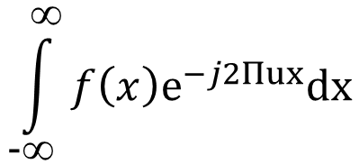
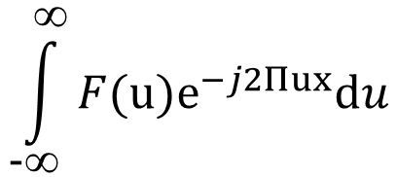
4.2 Fourier Transform &Frequency Domain
  4.2.1 The One-Dimensional Fourier Transform and Inverse Fourier Transform Pair
  The Fourier transform, F(u), of a single variable, continuous
  function, f (x), is defined by the equation
  inverse Fourier transform:
  These two equations comprise the Fourier transform pair
F（u）=
F（x）=

Slide 8
4.2 Fourier Transform &Frequency Domain
  DFT: Discrete Fourier Transform
  The Fourier transform of a discrete function of one variable,
  f ( x ) , x, u = 0,1,2,. . . , M - 1, is given by the equation:
  inverse Fourier transform:
each term of the Fourier transform [F(u) for each value of u] is composed of the sum of all values of the function f (x)

Slide 9
4.2 Fourier Transform &Frequency Domain
  DFT: Discrete Fourier Transform
  follows directly from Euler's formula :
  We can obtain:
The domain (values of u) over which the values of F(u) range is appropriately called the frequency domain
Each of the M terms of F(u)s called a frequency component of the transform
power spectrum:
P(u) =|F(u)|²

Slide 10
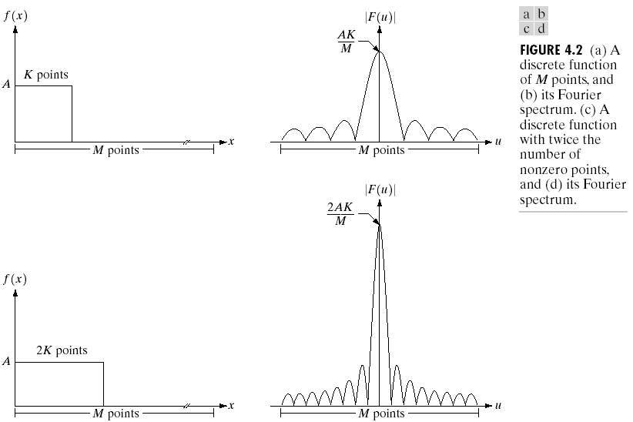
4.2 Fourier Transform &Frequency Domain
  the height of the spectrum doubled as the area under the curve in x- domain doubled
  the number of zeros in the spectrum in the same interval doubled as the length of the function doubled.
This “reciprocal（对偶）" nature of the Fourier transform pair is most useful in interpreting results of image processing in the frequency domain.

Slide 11
4.2 Fourier Transform &Frequency Domain
4.2.2 The two-dimensional Fourier Transform and its inverse
The discrete Fourier transform of a function (image) f (x,y) of size MxN is given by the equation:
  inverse Fourier transform:

Slide 12

4.2 Fourier Transform &Frequency Domain
It is common practice to multiply the input image function by (-1)^{x+y} prior to computing the Fourier transform:
the Fourier transform of f(x, y)(-1)^{x+y} [that is, F(0, 0)] is located at u = M/2 and v = N/2. ⬄ shifts the origin of F(u, v ) to frequency coordinates (M/2, N/2) which is the center of the M x N area occupied by the 2-D DFT:
Power
P(u, v) =|F(u, v)|²

Slide 13
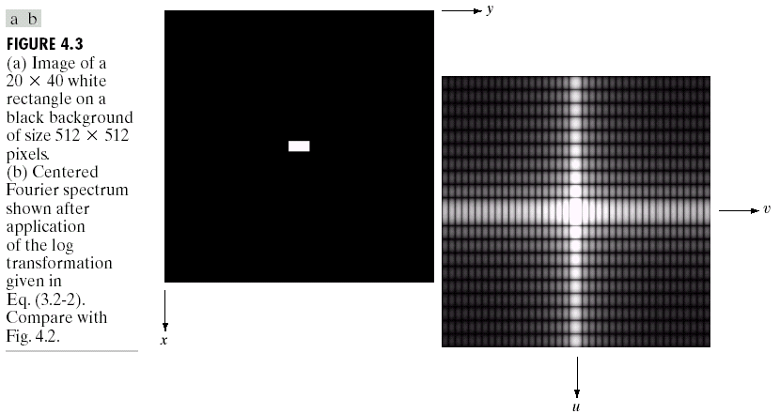
4.2 Fourier Transform &Frequency Domain
the separation of spectrum zeros in the u-direction is exactly twice the separation of zeros in the v direction. This corresponds inversely to the 1-to-2 size ratio of the rectangle in the image.
The spectrum was processed prior to displaying by using the log transformation (similarly processed in most Fourier transformation)

Slide 14
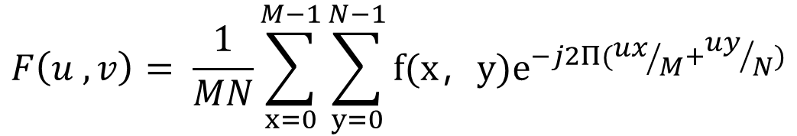
4.2 Fourier Transform &Frequency Domain
4.2.3 Filtering in the frequency domain
  Some basic properties of the frequency domain
frequency is directly related to rate of change:
frequencies in the Fourier transform ⬄ patterns of intensity variations in an image
  slowest varying frequency component (u = v = 0) ⬄ average intensity.
  The low frequencies ⬄ the slowly varying components of an image
  Eg: smooth gray-level variations on the walls and floors of the room
  higher frequencies ⬄ faster gray level changes in the image.
  Eg: the edges of objects and other components of an image characterized by abrupt changes in gray level, such as noise.

Slide 15
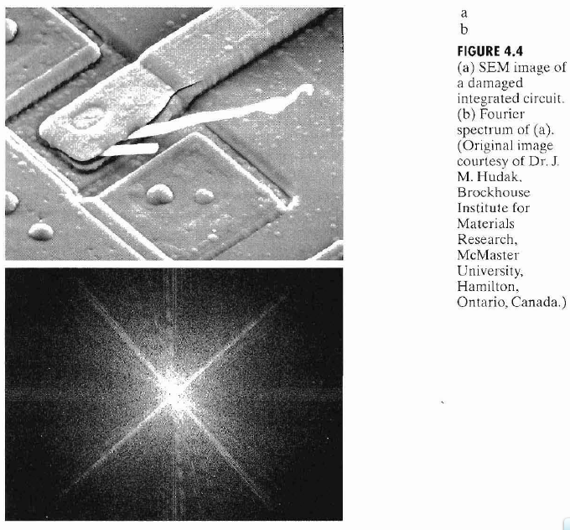
4.2 Fourier Transform &Frequency Domain
±45º strong edges
⬄
±45º prominent components
two white thermal failure
⬄
vertical component off-axis slightly to the left

Slide 16
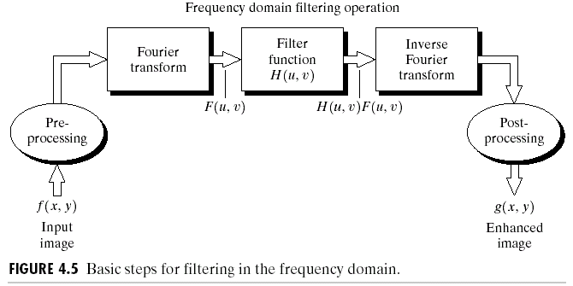
4.2 Fourier Transform &Frequency Domain
  Basics of filtering in the frequency domain
  Multiply the input image by (-1)^{x+y} to center the transform
  Compute F(u, v) , the DFT of the image from (1).
  Multiply F(u, v) by a filter function H (u, v).
  Compute the inverse DFT of the result in (3).
  Obtain the real part of the result in (4).
  Multiply the result in (5) by (-1)^{x+y} .

Slide 17
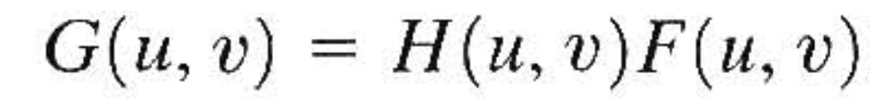
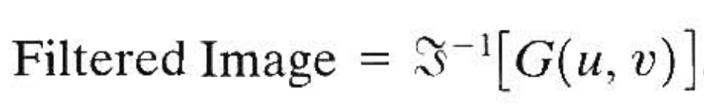
4.2 Fourier Transform &Frequency Domain
H(u, v) is called a filter (or filter transfer function):
it suppresses certain frequencies in the transform while leaving others unchanged.
The Fourier transform of the output image is given by:
The filtered image is obtained simply by taking the inverse Fourier transform of G(u, v):

Slide 18
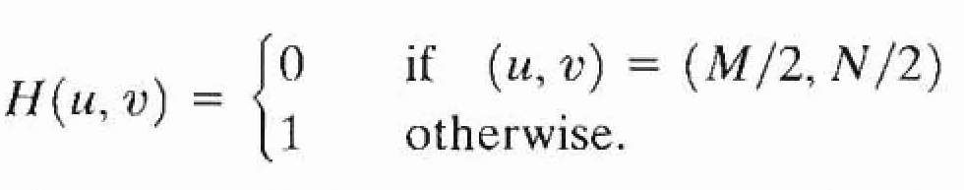
4.2 Fourier Transform &Frequency Domain
  Some basic filters and their properties
  notch filter(陷波滤波器):
Set F(0,0) to zero and leave all other frequency components untouched.
A notch filter is a constant function with a hole (notch) at the origin.

Slide 19
4.2 Fourier Transform &Frequency Domain
lowpass filter and highpass filter
A filter that attenuates high frequencies while "passing" low frequencies is called a lowpass filter.
A filter that has the opposite characteristic is appropriately called a highpass filter.
Low frequencies: responsible for the general gray-level appearance of an image over smooth areas.
High frequencies: responsible for sharp details, such as edges and noise.

Slide 20
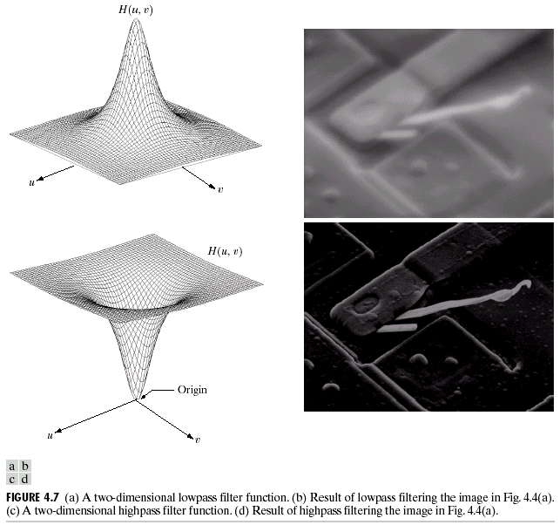
4.2 Fourier Transform &Frequency Domain

Slide 21
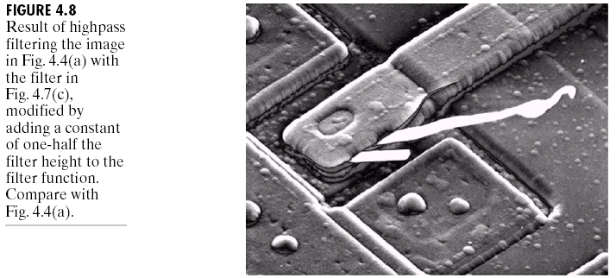
4.2 Fourier Transform &Frequency Domain
A procedure often follow highpass filter is to add a constant to the filter so that it will not completely eliminate F(0, 0).
The improvement over Fig, 4.7(d) is evident

Slide 22
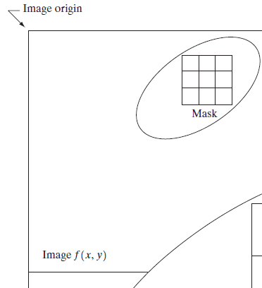
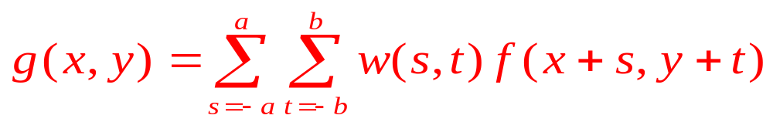
4.2 Fourier Transform &Frequency Domain
4.2.4 Correspondence between filtering in the spatial and frequency domains
The most fundamental relationship between the spatial and frequency domains is established by a well-known result called the convolution theorem.
The process by which we move a mask from pixel to pixel in an image, and compute a predefined quantity at each pixel, is the foundation of the convolution process.

Slide 23
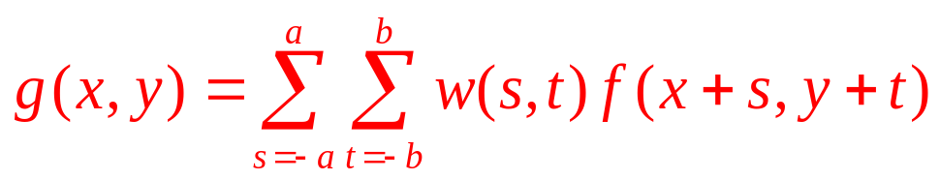
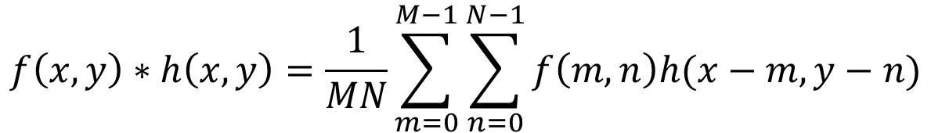

4.2 Fourier Transform &Frequency Domain
Formally, the discrete convolution of two functions f(x , y) and h(x, y) of size M X N is denoted by f(x , y) * h(x, y) and is defined by the expression
Letting F(u, u) and H(u, v) denote the Fourier transforms of f(x , y) and h(x, y) the frequency domain, respectively, left (spatial convolution) can be obtained by taking the inverse Fourier transform of the. Conversely. the right can be obtained by taking the forward Fourier transform of the expression on the left
f (x , y)*h (x , y)
F(u , v) H(u , v)
f (x , y)h (x , y)
F(u , v) * H(u , v)

Slide 24
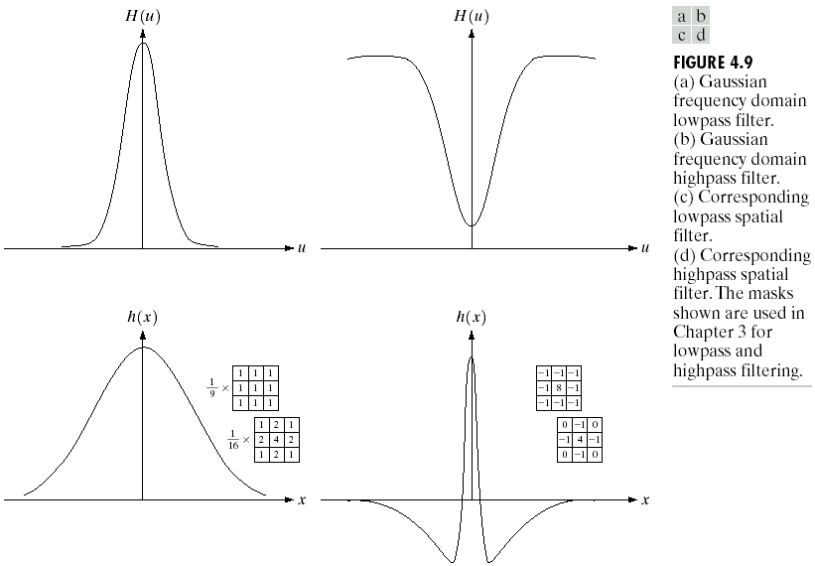
4.2 Fourier Transform &Frequency Domain
Lowpass: narrower frequency filter⬄ wider spatial filter⬄ more blurring
Highpass: reciprocity in width, and spatial filter has both negative and positive values

Slide 25
4.2 Fourier Transform &Frequency Domain
Basic "model" for filtering
three types of lowpass filters H(u, v) :
  Ideal filters (very sharp, high Butterworth )
  Butterworth filters (parameter)
  Gaussian filters (very smooth, low Butterworth)

Slide 26
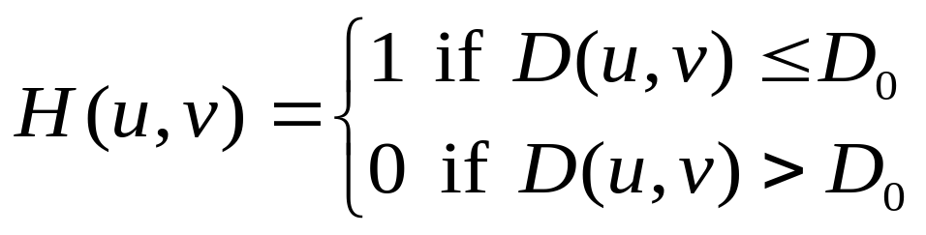
4.3 Smoothing frequency-domain filters
  4.3.1 Ideal lowpass filters
  The simplest lowpass filter: "cuts off" all high-frequency components of the Fourier transform that are at a distance greater than a specified distance D0 from the origin of the (centered) transform
  A two-dimensional (2-D) ideal lowpass filter (ILPF):
where Do is a specified nonnegative quantity, and D (u, v) is the distance from point (u, v) to the center of the frequency rectangle.

Slide 27
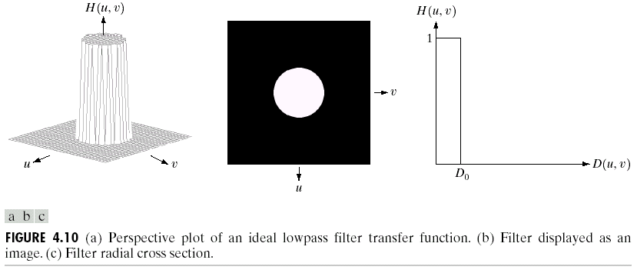
4.3 Smoothing frequency-domain filters
cutoff frequency: the point of transition between H(u, v) = 1 and H(u, v) = 0.
In the case of Fig. 4.10, for example, the cutoff frequency is D₀

Slide 28
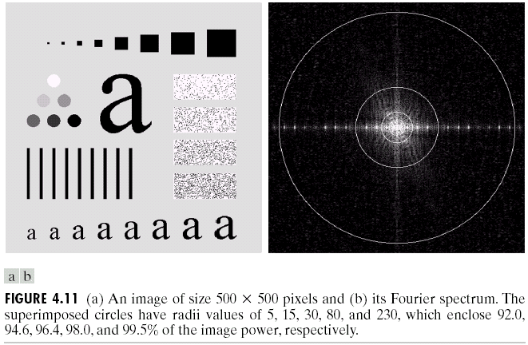
4.3 Smoothing frequency-domain filters

Slide 29
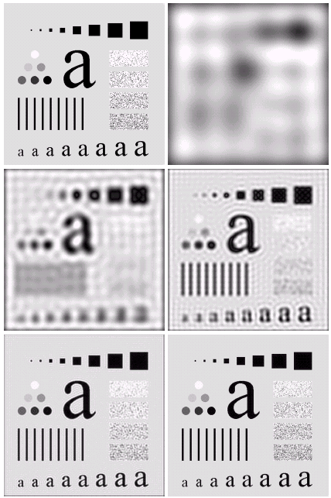
4.3 Smoothing frequency-domain filters
Radii value ：5
92% 8%
Radii value ：15
94.6% 5.4%
Radii value ：30
96.4% 3.6%
Radii value ：80
98% 2%
Radii value ：230
99.5% 0.5%

Slide 30
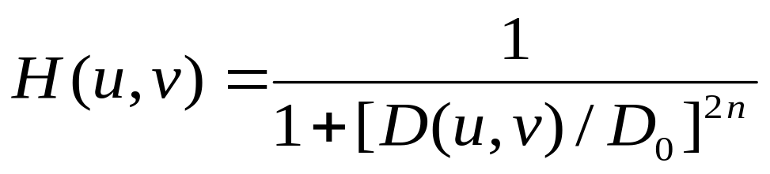
4.3 Smoothing frequency-domain filters
4.3.2 Butterworth lowpass filters
The transfer function of a Butterworth lowpass filter (BLPF) of order n, and with cutoff frequency at a distance D₀, from the origin, is defined as
1/2

Slide 31
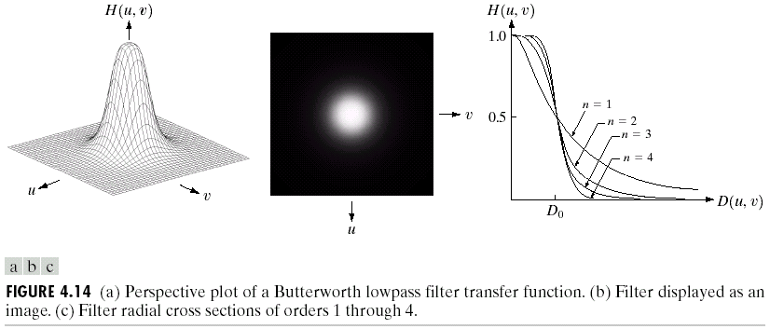
4.3 Smoothing frequency-domain filters

Slide 32
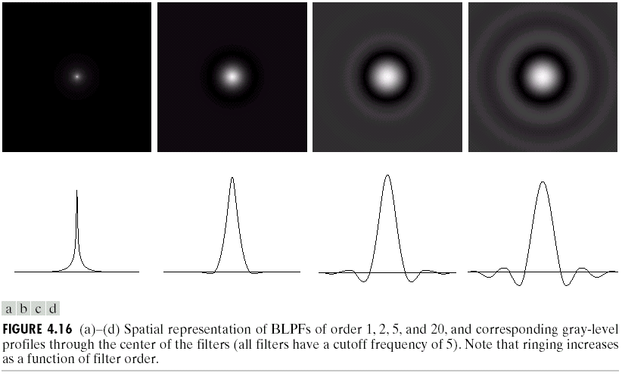
4.3 Smoothing frequency-domain filters
Rings increased as a function of filter order.

Slide 33
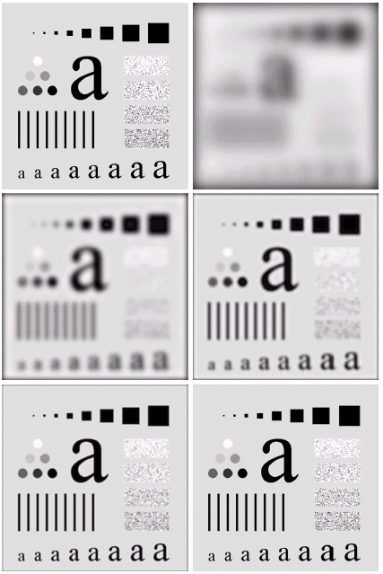
4.3 Smoothing frequency-domain filters
ILPF
BLPF
Radii value ：
5，15，
30，80，230
BLPF：
Ring slightly

Slide 34
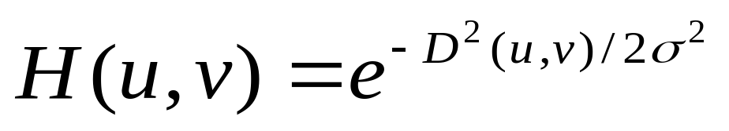
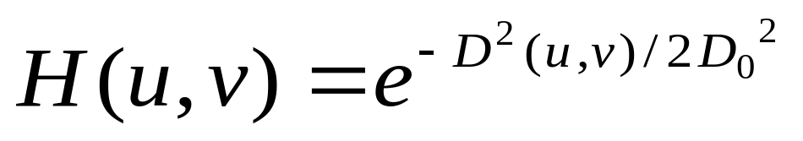
4.3 Smoothing frequency-domain filters
4.3.3 Gaussian lowpass filters
The form of Gaussian lowpass filters in two dimensions:
D(u, v) is the distance from the origin of the Fourier transform.
is a measure of the spread of the Gaussian curve.
By letting = D₀, we can express the filter in a more familiar form in terms of the notation in this section (D₀, is the cutoff frequency):

Slide 35
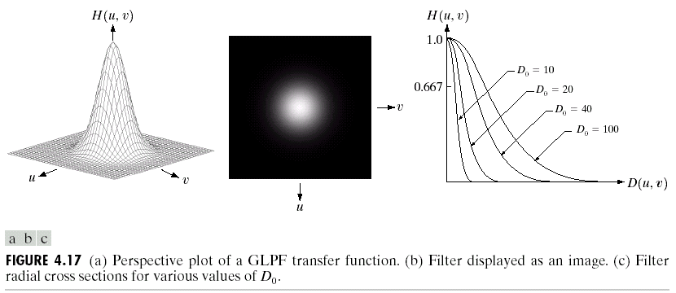
4.3 Smoothing frequency-domain filters

Slide 36
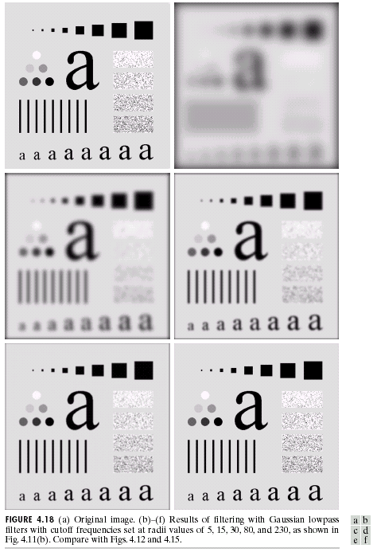
4.3 Smoothing frequency-domain filters
BLPF
GLPF
Radii value ：
5，15，
30，80，230
GLPF：
NOT Ring
Less compact
4

Slide 37
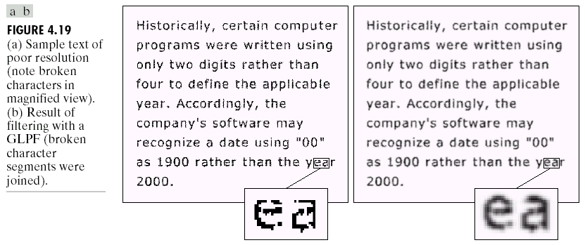
4.3 Smoothing frequency-domain filters
4.3.4 Additional examples of lowpass filtering
The characters have distorted shapes due to insufficient resolution, and many characters are broken.
It is difficult for machine recognition systems to read these broken characters.
Simple processing of Gaussian low-pass filter repairs characters well.

Slide 38
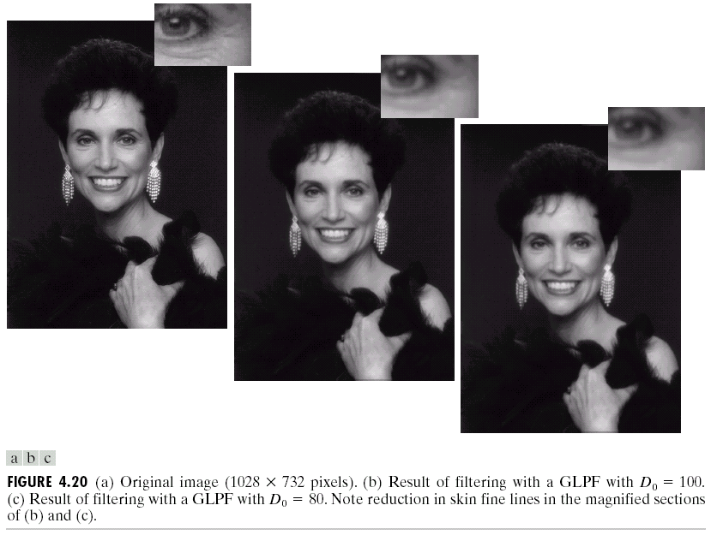
4.3 Smoothing frequency-domain filters
the image looks gentle and smooth.
it can reduce skin fine lines, etc.
Original
GLPF with D0=100
GLPF with D0=80

Slide 39
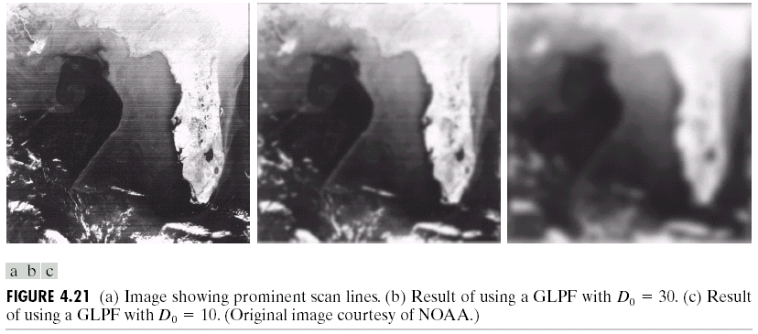
4.3 Smoothing frequency-domain filters

Slide 40
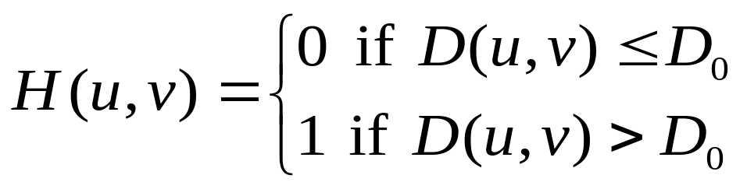
4.4 Sharpening frequency domain filters
4.4.1 Ideal highpass filters
  A 2-D ideal highpass filter (IHPF) is defined as
1/2
D₀ is the cutoff distance measured from the origin of the frequency rectangle.

Slide 41
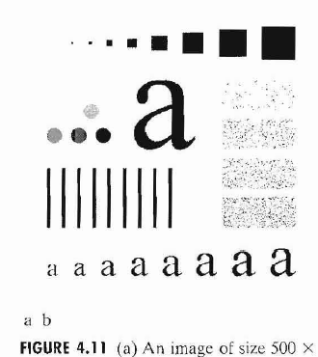
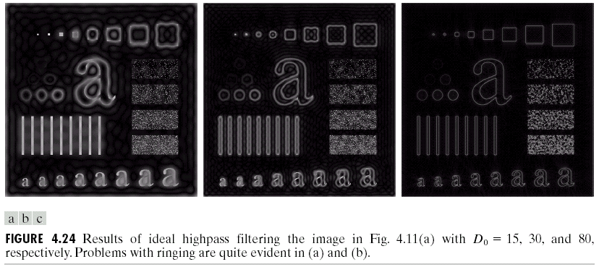
4.4 Sharpening frequency domain filters
IHPF usually has ringing properties.
The tiny objects and lines are strengthened and appear white.

Slide 42
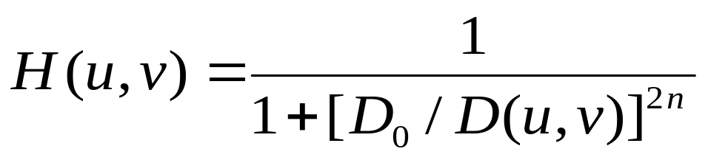
4.4 Sharpening frequency domain filters
4.4.2 Butterworth highpass filters
The transfer function of the Butterworth highpass filter (BHPF) of order n and with cutoff frequency locus at a distance Do from the origin is given by

Slide 43
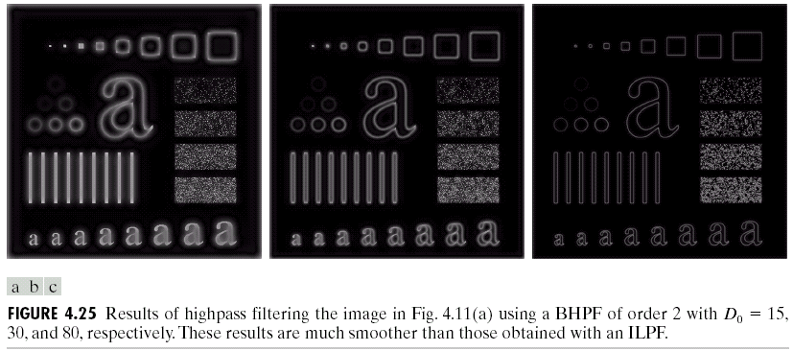
4.4 Sharpening frequency domain filters

Slide 44
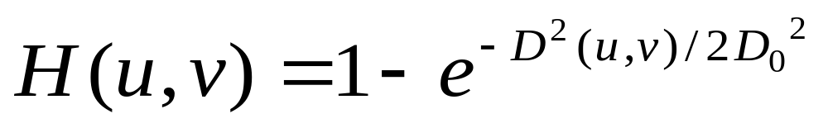
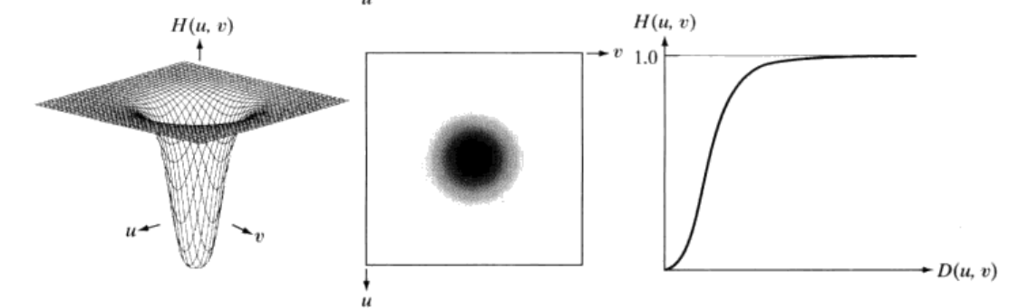
4.4 Sharpening frequency domain filters
4.4.3 Gaussian highpass filters
The transfer function of the Gaussian highpass filter (GHPF) with cutoff frequency locus at a distance D₀, from the origin is given by

Slide 45
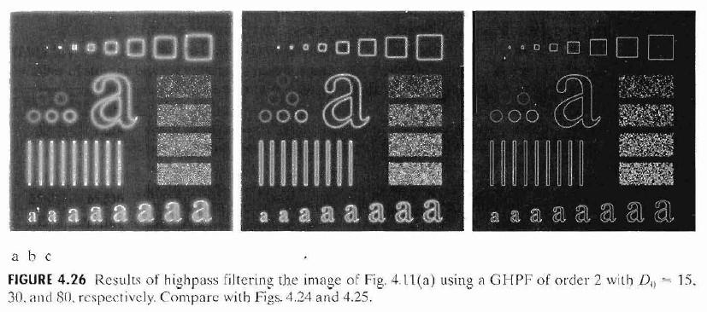
4.4 Sharpening frequency domain filters
As expected, the results obtained are smoother than with the previous two filters. Even the filtering of the smaller objects and thin bars is cleaner

Slide 46
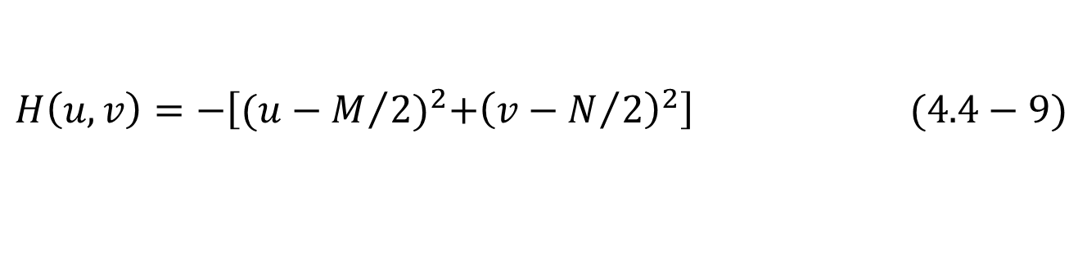
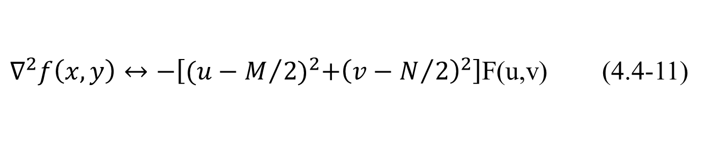
4.4 Sharpening frequency domain filters
4.4.4 Laplacian in the frequency domain
The centered Laplacian filter:
The Laplacian-filtered image in the spatial domain is obtained by computing the Inverse Fourier transform of H(u, v) F (u, v)

Slide 47
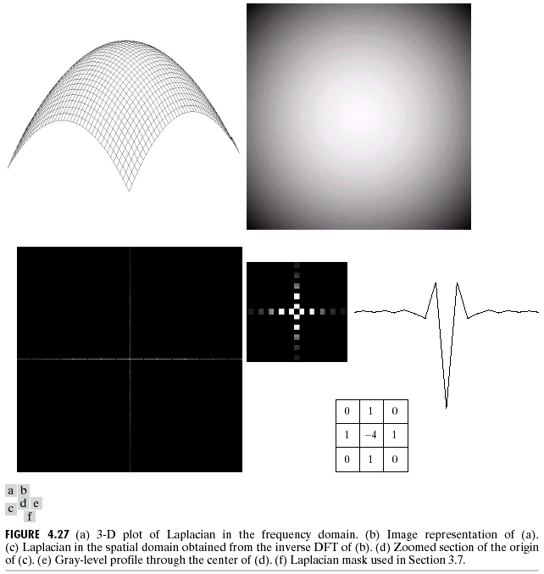
4.4 Sharpening frequency domain filters
A horizontal profile through the center of this mask has the same basic shape as the profile in Fig. 4.27(e) (that is, a negative value between two smaller positive values). It is of interest to note that, had we started in the frequency domain, we would have been led to a spatial mask similar in form to Fig. 3.39(a).

Slide 48
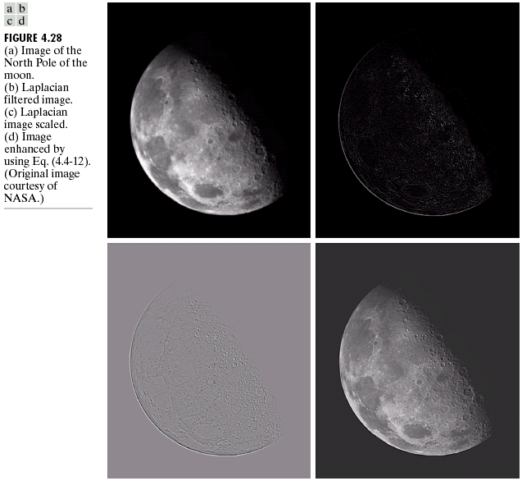
4.4 Sharpening frequency domain filters
we form an enhanced image g(x, y) by subtracting the
Laplacian from the original image:
(b) Laplacian filtered image in frequency domain
(c) Scaling: negative and positive values in (b)
(d) Substract (a) and (c)

Slide 49


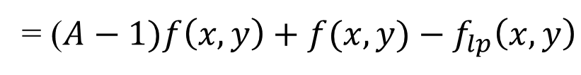
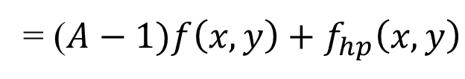
4.4 Sharpening frequency domain filters
4.4.5 Unsharp masking, high-boost filtering, and high-frequency emphasis filtering
Unsharp masking: generate a sharp image by subtracting a blurred version from an image
frequency domain: obtaining a highpass-filtered image by subtracting a lowpass-filtered version from the image.
High-boost filtering: generalizes this by multiplying f( x , y) by a constant A >= 1:

Slide 50
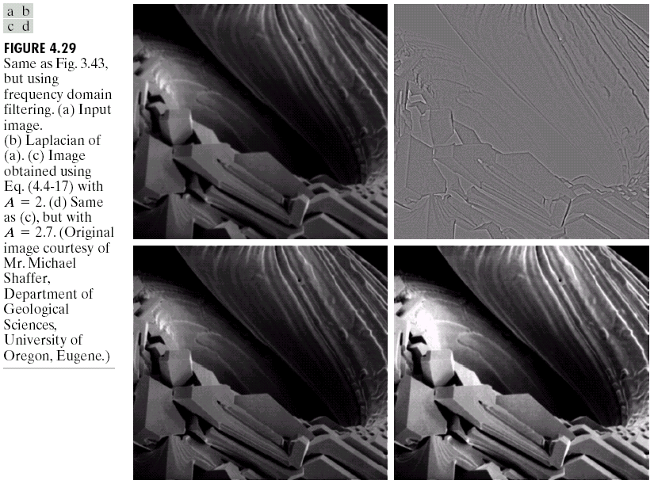
4.4 Sharpening frequency domain filters

Slide 51

4.4 Sharpening frequency domain filters
High-frequency emphasis filtering
it is advantageous to accentuate the contribution by the high-frequency components.
Multiply a highpass filter function by a constant and add an offset so that the zero frequency is not eliminated
where a> 0 and b > a. Typically, 0.25< a< 0.5, 1.5 < b <2.0.
When a = ( A-1) and b = 1: high-frequency emphasis reduces to high-boost filtering
When b > 1, the high frequencies are emphasized, thus giving this procedure its name.

Slide 52

4.4 Sharpening frequency domain filters

Slide 53
4.4 Sharpening frequency domain filters
Fast Fourier Transform
The reason that Fourier based techniques have become so popular is the development of the Fast Fourier Transform (FFT) algorithm
Allows the Fourier transform to be carried out in a reasonable amount of time
Reduces the amount of time required to perform a Fourier transform by a factor of 100 – 600 times!

Slide 54
4.4 Sharpening frequency domain filters
Frequency Domain & Spatial Domain Filtering
Similar jobs can be done in the spatial and frequency domains
Filtering in the spatial domain can be easier to understand
Filtering in the frequency domain can be much faster – especially for large images

Slide 55
4.5 Summary
In this Chapter we examined image enhancement in the frequency domain
  The Fourier series & the Fourier transform
  Image Processing in the frequency domain
    Image smoothing
    Image sharpening
  Fast Fourier Transform
Next time we will begin to examine image restoration using the spatial and frequency based techniques we have been looking at

